Slide 1
DOUBLE TROUBLE/TWO IS MEJ CHE ONE IN THE LONG TERM?
Outcome negli interventi a doppia o singola anastomosi
Mario musella m.d.
Advanced Biomedical Sciences Department
Naples Federico ii university

Slide 2

Disclosure
J&J
X
Medtronic
X
Lilly
X

Slide 3
THE QUESTION
Does one anastomosis really mean less trouble?
TWO ANASTOMOSES
ONE ANASTOMOSIS
THE REAL ENDPOINT
Not “how many anastomoses?”
How much durable benefit do we buy per unit of long-term risk?
RYGB / BPD-DS / TB
More reconstruction
More mature evidence
Different late-risk profile
OAGB / SADI-S / SASI
Less reconstruction
Potentially shorter operation
Physiology still matters
FRAMEWORK
RYGB vs OAGB
BPD/DS vs SADI-S
Transit Bipartition vs SASI
Decision Algorithm
The Answer

Slide 4
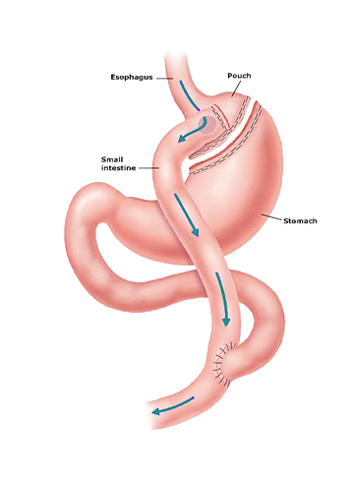
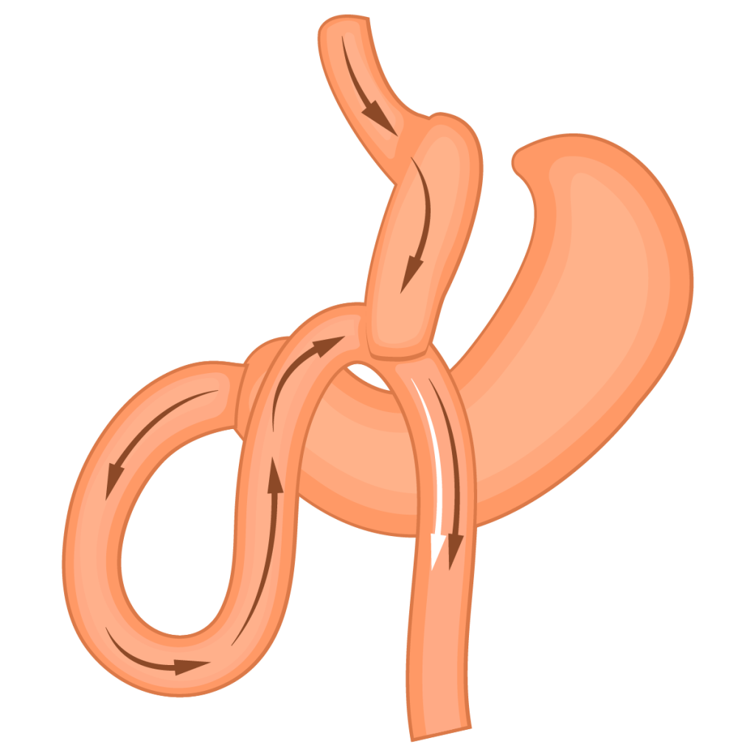
PAIR 1 | ANATOMY
RYGB vs OAGB : the anatomical bargain
One fewer anastomosis removes a reconstruction step, but changes bile–food mixing.
RYGB
OAGB
WHAT CHANGES?
Small pouch
↓
Gastrojejunostomy
↓
Roux limb
Bile separated from food proximally
Long gastric pouch
↓
Single gastrojejunostomy
Bile and food share the alimentary limb proximally
RYGB: more complex, stronger reflux-control anatomy but higher internal hernias rate
OAGB: simpler reconstruction, but bile reflux becomes a central long-term question

Slide 5
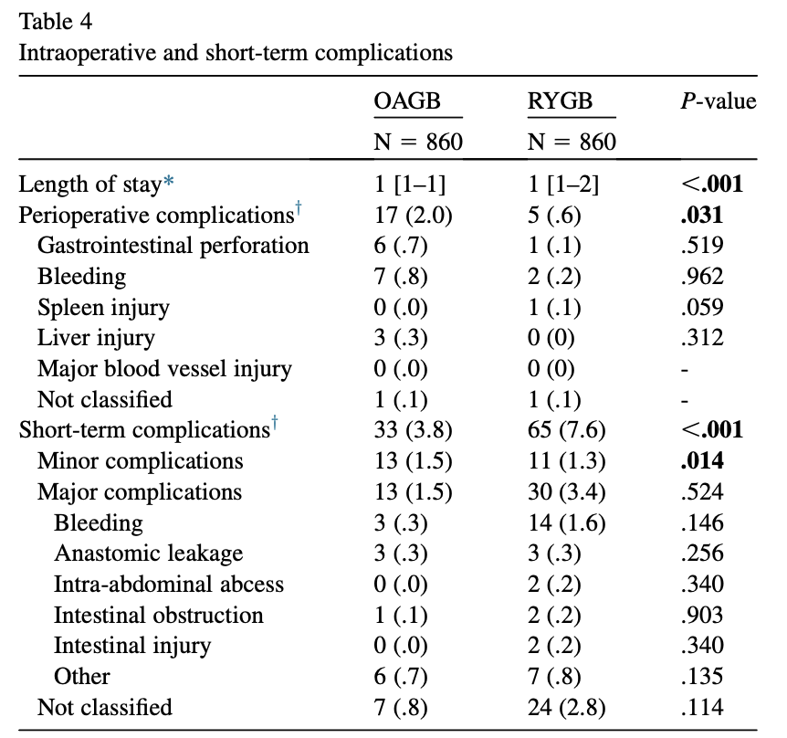
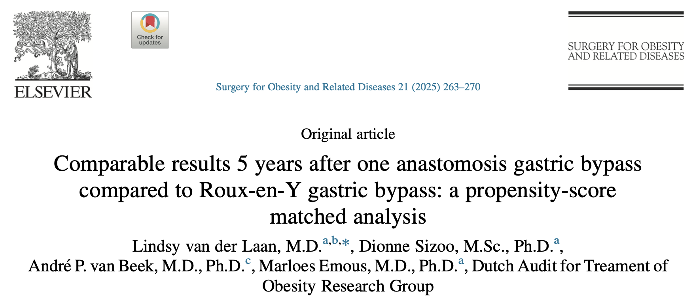
PAIR 1 | SHORT TERM
RYGB vs OAGB : perioperative and 5-year outcomes
Large nationwide cohort: 1:1 propensity-score matched of 860 vs 860 pts
1
2
≈
✓
%TWL at 5 years
OAGB 30.0% | RYGB 28.8%
%EWL at 5 years
OAGB 74.0% | RYGB 72.3%
T2DM remission
OAGB 60.5% | RYGB 69.4%
HTN remission
OAGB 60.2% | RYGB 45.5% • p=0.015
5-year answer: similar weight loss and diabetes remission — with different complication trade-offs.

Slide 6
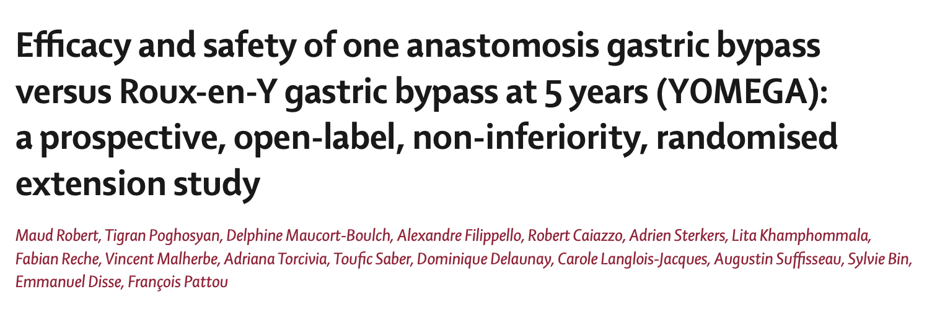
PAIR 1 | 5 YEARS
Weight loss: OAGB does not lose the efficacy race
OAGB
75.6%
75.6%
OAGB 5-y %EBMIL
RYGB
71.4%
71.4%
RYGB 5-y %EBMIL
YOMEGA: OAGB remained non-inferior to RYGB for long-term weight loss.

Slide 7
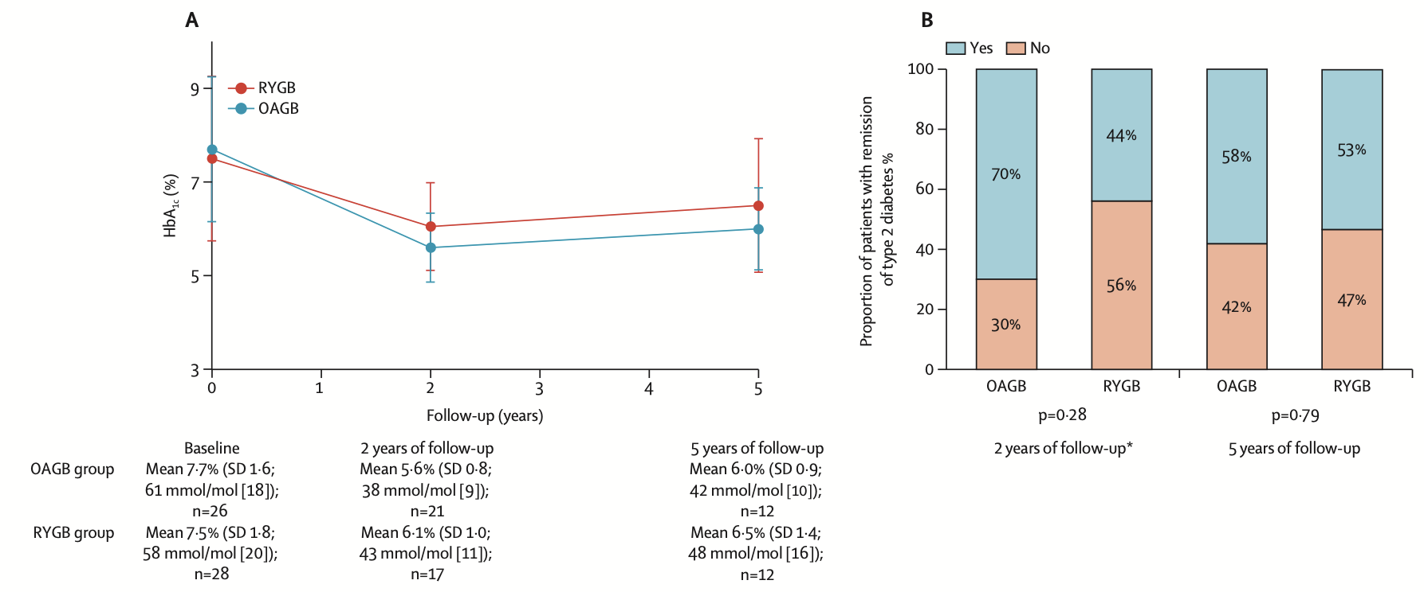
PAIR 1 | METABOLIC
Metabolic outcomes: OAGB matches RYGB
T2DM REMISSION
58% OAGB
vs 53% RYGB
p = 0.79
HbA1c AT 5 YEARS
6.0% OAGB
vs 6.5% RYGB
p = 0.49
OTHER METABOLIC OUTCOMES
Hypertension remission
48% OAGB vs 39% RYGB
p = 0.57
Dyslipidemia remission
45% OAGB vs 62% RYGB
p = 0.43
OSA remission
97% OAGB vs 93% RYGB
p = 0.37

Slide 8
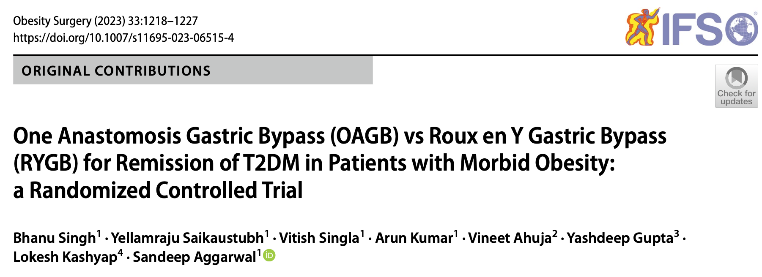
PAIR 1 | METABOLIC
Metabolic outcomes: OAGB matches RYGB
Randomized trial with T2DM as the primary endpoint
86.4%
85.7%
72.2%
71.4%
T2DM remission at 1 year
OAGB
T2DM remission at 1 year
RYGB
T2DM remission at 4 years
OAGB
T2DM remission at 4 years
TYGB
4-YEAR RYGB: 71.4%
No significant difference at any time point.
Hypertension remission at 4 years:
58.3% OAGB vs 53.3% RYGB (p=0.95)
HbA1c at 1 year: 5.5% OAGB vs 5.6% RYGB — comparable glycaemic control.
OSA remission at 4 years: 75% OAGB vs 90% RYGB (p=0.40). Overall metabolic outcomes were comparable.

Slide 9
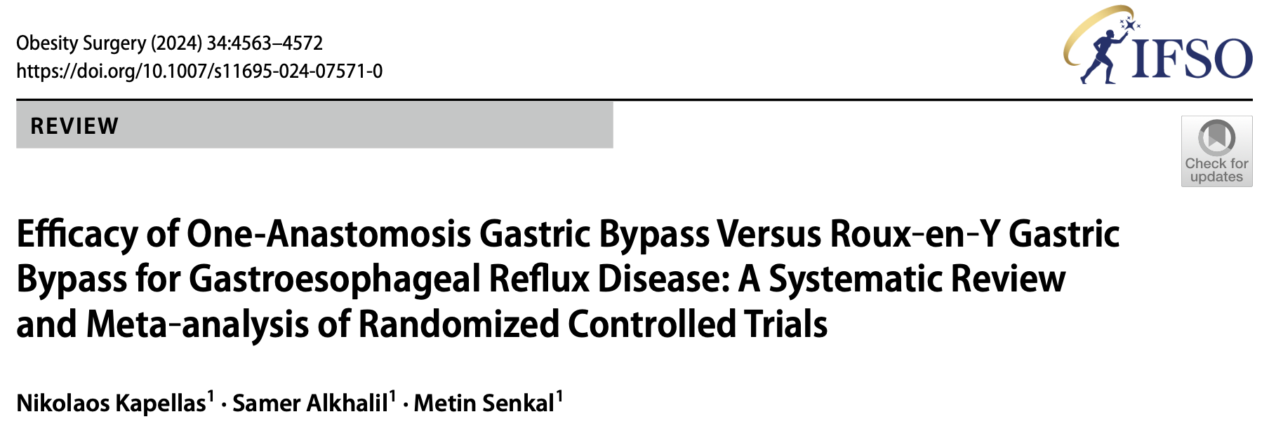
PAIR 1 | REFLUX
The Achilles’ heel of OAGB: reflux
Nine randomized trials show a consistent reflux disadvantage for OAGB.
18.5%
7.6%
5.65×
Postoperative GERD — OAGB
Postoperative GERD — RYGB
Higher odds of DE NOVO GERD
with OAGB
WHY IT MATTERS
INTERPRETATION
De novo GERD: 8.5% OAGB vs 0.5% RYGB.
Pooled OR 5.65 (95% CI 1.53–20.82; p<0.05).
Sensitivity analyses remained significant (OR 2.60–4.33).
GERD remission was high in both groups:
78.4% OAGB vs 87.4% RYGB (OR 0.32; p=0.19).
Endoscopic esophagitis: 16.5% vs 11.25% (OR 1.63; p=0.35).
One RCT reported conversion for GERD: 7.2% OAGB vs 0 RYGB.

Slide 10
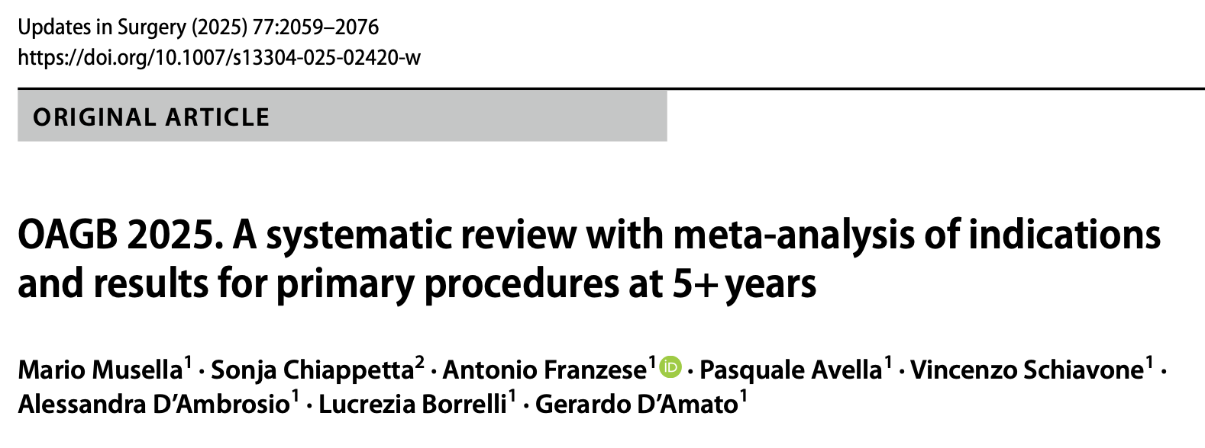
PAIR 1 | OAGB — LONG-TERM SAFETY
Long-term complications are real : but not all are equally frequent
5+ years of follow-up • 22 studies • 14,692 primary OAGB patients • mean FU 89 months
MALNUTRITION
IRON / PROTEIN
BILE REFLUX
MARGINAL ULCER
Up to 34.3% reported in one long-term cohort
→ The review stresses lifelong supplementation and nutritional surveillance.
Iron-deficiency anaemia: 1%
Hypoalbuminaemia / protein–energy malnutrition: 0.09%
→ Deficiencies may require dietary therapy or revision when severe.
0.8–9.8% across the long-term evidence set
→ Symptomatic worsening of reflux was reported in 27% in one cohort.
0.19–7.7% at long-term follow-up
→ Overall frequency is comparable with ranges reported after RYGB.
REVISION: 0.19–5.21% • commonly for severe bile reflux or marginal-ulcer complications

Slide 11
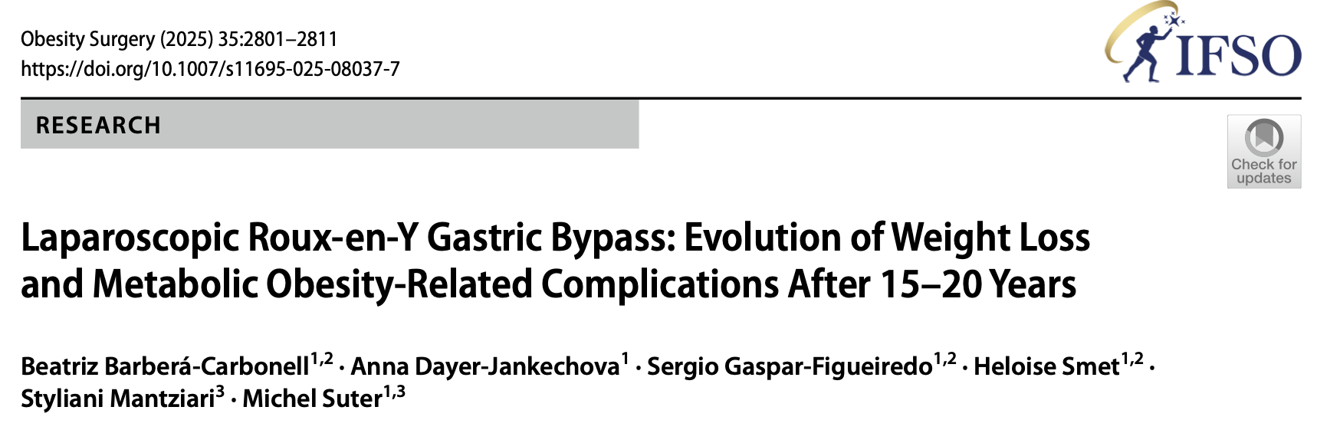
PAIR 1 | RYGB — LONG-TERM SAFETY
RYGB : long-term morbidity is driven by late surgical events
15–20 years of follow-up • 944 primary laparoscopic RYGB patients • FU 91.7% at 10 years, 74.5% at 15 years
LATE MORBIDITY
INTERNAL HERNIA
REOPERATION
NUTRITIONAL SURVEILLANCE
18.5% developed a long-term complication (>30 days)
→ 178 patients experienced late procedure-related morbidity.
8.5% developed internal hernia
2.9% had partial / total SBO
→ IH was the most common late complication.
14.2% underwent reoperation during follow-up
→ 134 patients required surgical reintervention; another 3.7% required diagnostic/therapeutic laparoscopy.
100% required micronutrient supplementation during follow-up
→ Nutritional monitoring remains an integral part of long-term RYGB care.
LATE PROFILE: internal hernia ± SBO • GJ stricture 4.0% • SBO unrelated to IH 3.7%

Slide 12


Slide 13
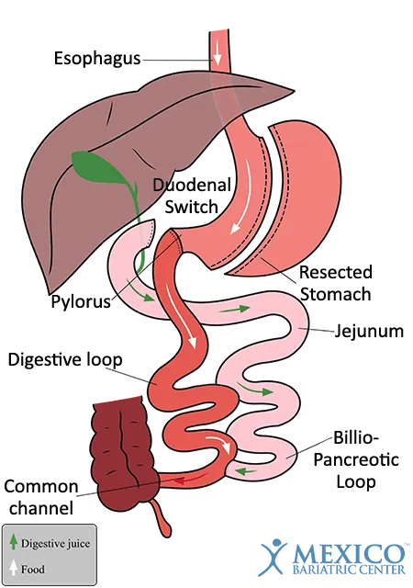
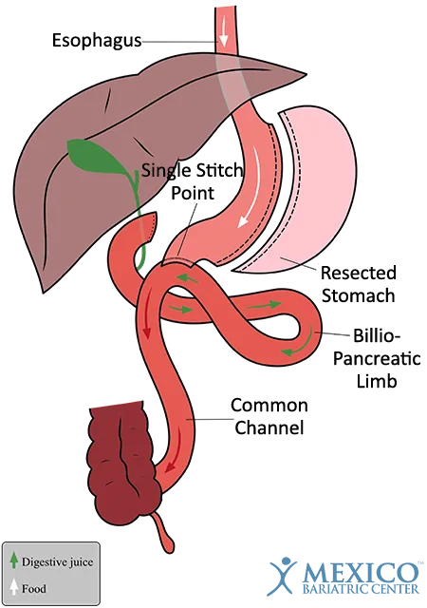
PAIR 2 | ANATOMY
BPD/DS vs SADI-S : simplifying the switch
BPD / DS
SADI-S
Sleeve
+ duodenal transection
+ duodeno-ileal anastomosis
+ jejunoileal anastomosis
Sleeve
+ duodenal transection
+ single duodeno-ileal anastomosis
SADI-S simplifies reconstruction — but the sleeve and powerful malabsorptive physiology remain.

Slide 14
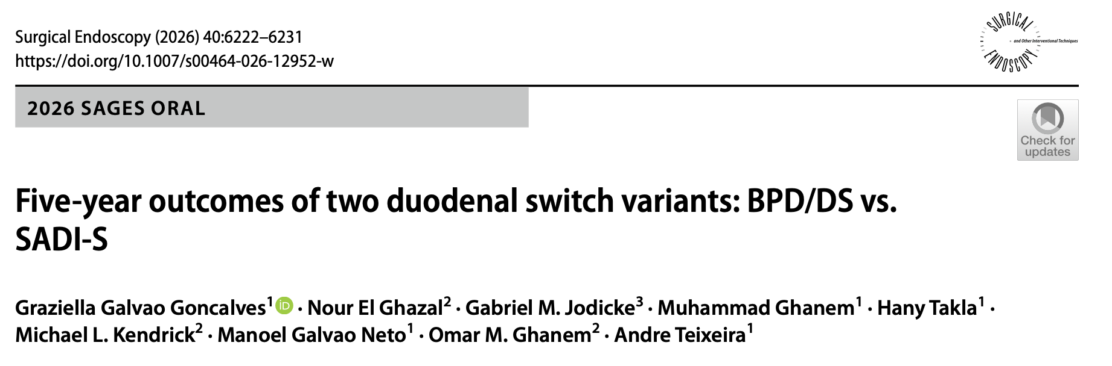
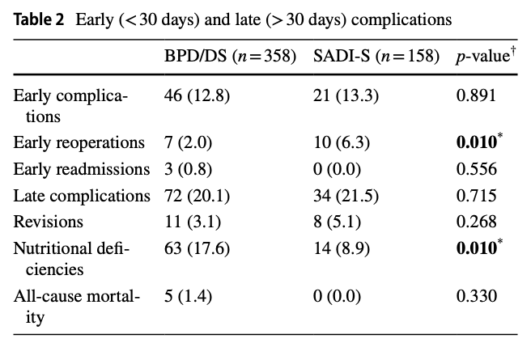
PAIR 2 | PERIOPERATIVE AND 5-YEAR COMPARATIVE RESULTS
Goncalves et al. 2026 • multicenter retrospective cohort • n=516 • 358 BPD/DS / 158 SADI-S
WEIGHT LOSS
OPERATIVE EFFICIENCY
5-y %TWL
37.14% SADI-S vs 35.61% BPD/DS
p = 0.434
Median operative time
150 vs 174 min
SADI-S −24 min; p < 0.001
At 5 years, efficacy was highly comparable; the main differentiators were shorter operative time with SADI-S, higher early reoperation after SADI-S, and a higher micronutrient-deficiency burden after BPD/DS.

Slide 15
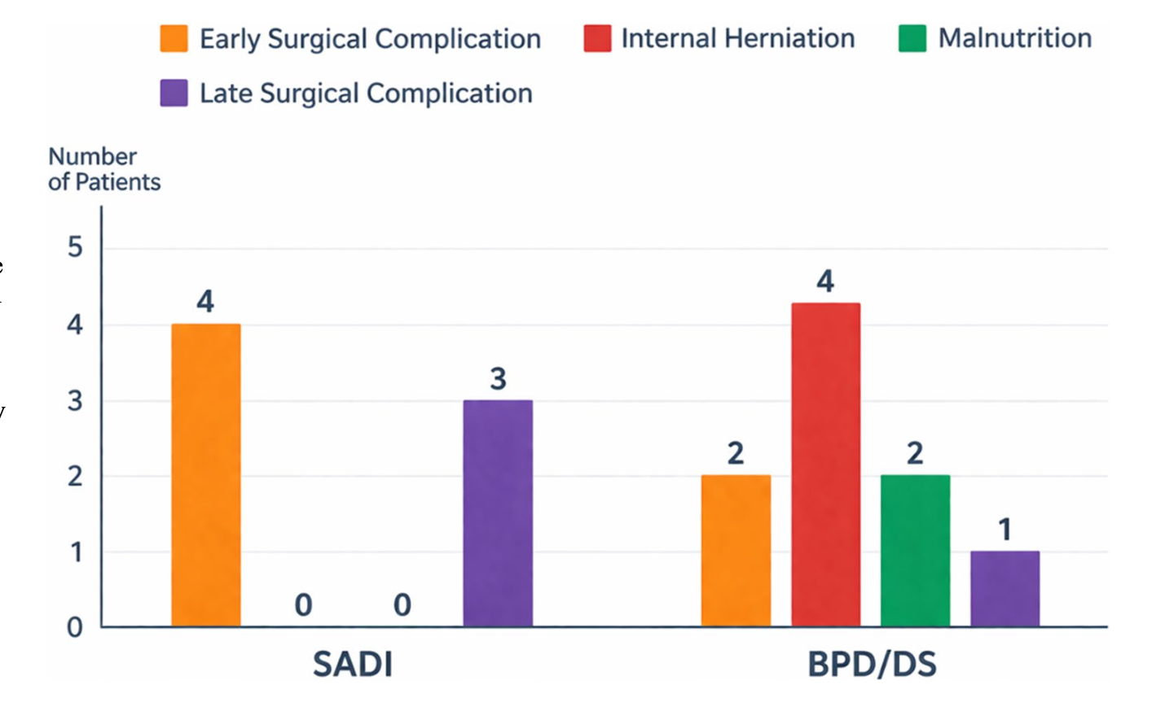
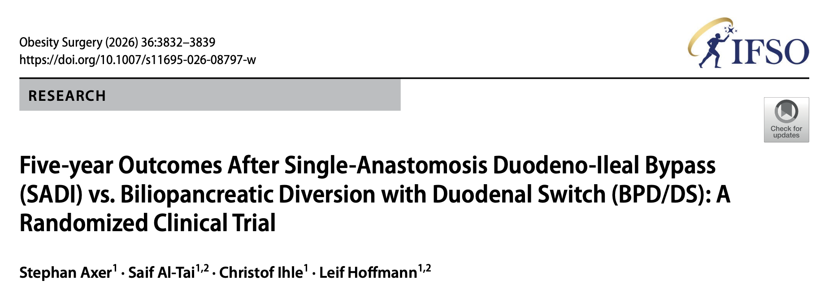
PAIR 2 | RANDOMIZED EVIDENCE
SADI vs BPD/DS : 5-year randomized evidence
Axer et al. 2026 • single-center RCT • treated n=56 • primary 5-y weight outcome available in n=47
34.3%
36.7%
REOPERATION PATTERN
Procedure-related reoperation:
6/29 SADI vs 6/27 BPD/DS
Internal herniation: 4 patients — BPD/DS only
Malnutrition-related corrective surgery: BPD/DS only
Observed 5-y %TWL
SADI
Observed 5-y %TWL
BPD/DS

Slide 16
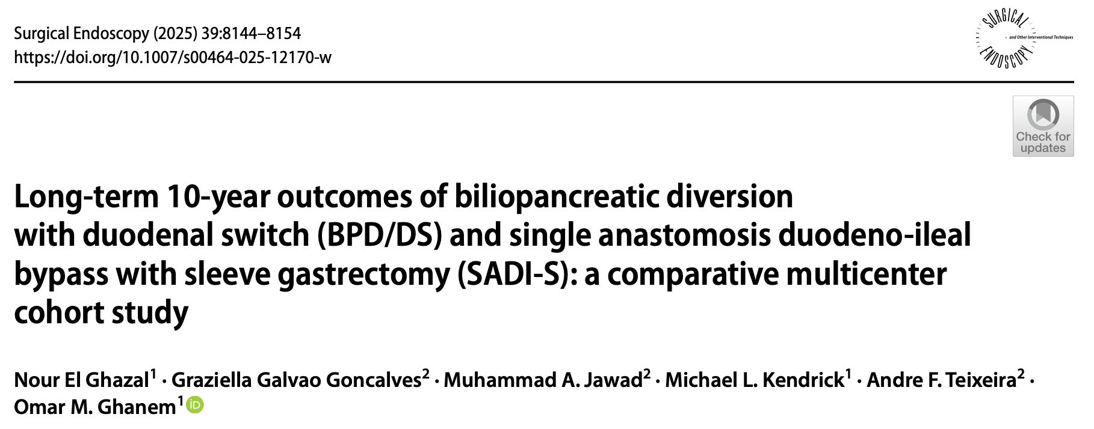
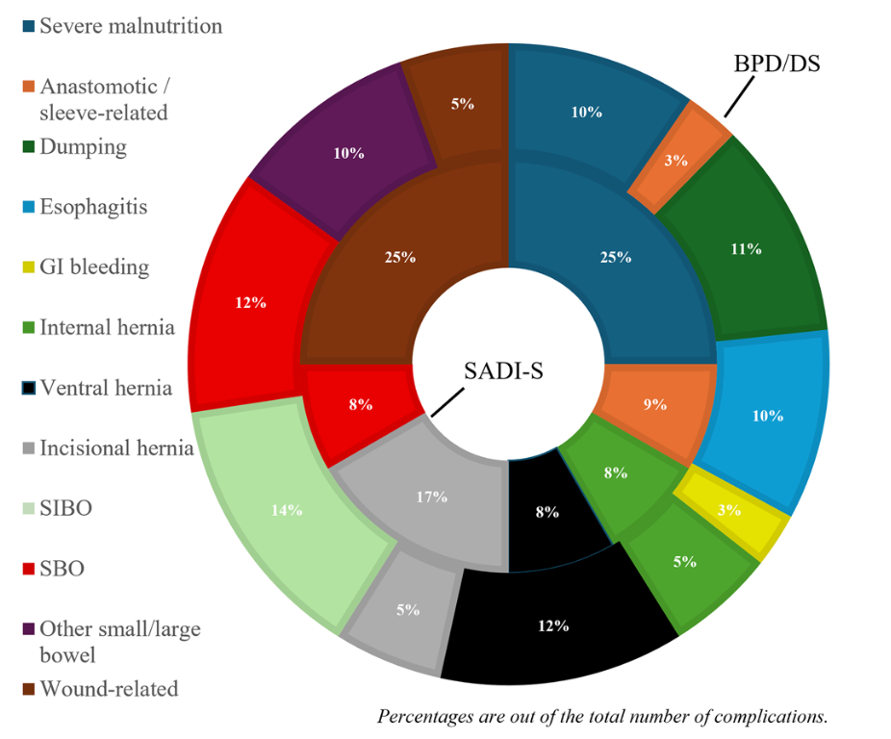
PAIR 2 | 10-YEAR COMPARATIVE EVIDENCE
BPD/DS vs SADI-S : similar efficacy, but a different nutritional burden
El Ghazal et al. 2025 • multicenter retrospective cohort • n=133 (101 BPD/DS; 32 SADI-S)
WEIGHT LOSS
METABOLIC RESPONSE
T2DM 80.0% vs 86.8%
HTN 69.6% vs 61.4%
HLD 88.9% vs 64.7%
OSA 80.0% vs 59.5%
→ No significant between-group differences
Maximum %TWL
47.3% SADI-S
45.7% BPD/DS
p = 0.418
→ No significant difference
NUTRITION
LATE SAFETY
Nutritional deficiencies
53.5% BPD/DS
15.6% SADI-S
p < 0.001
→ Largest observed between-group difference
Late complications
44.6% BPD/DS
31.3% SADI-S
p = 0.183
Revisions: 7.9% vs 12.5%
p = 0.482
→ No significant difference
At 10 years, weight loss and metabolic remission were similar. The clearest separation was nutritional: deficiencies were substantially more frequent after BPD/DS.

Slide 17
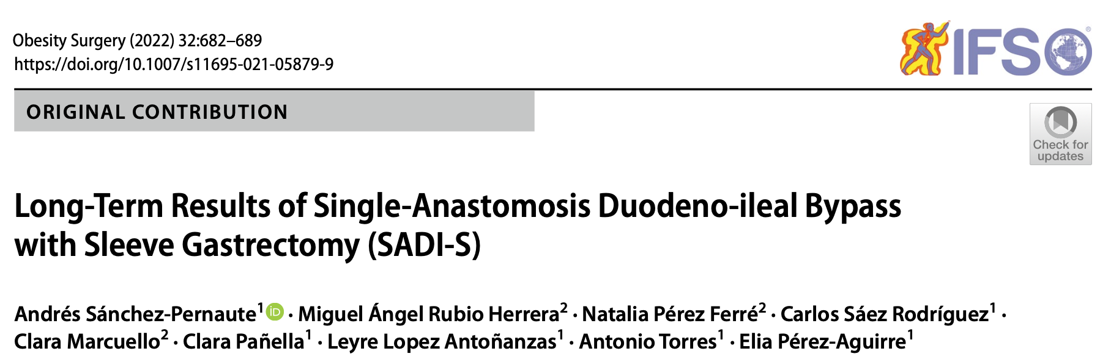
THE PYLORUS PARADOX
Pylorus preserved but is SADI-S really “reflux safe”?
THE PYLORUS
THE SLEEVE
THE PARADOX
Preserved in SADI-S
• Regulates gastric emptying
• Keeps reconstruction post-pyloric
• May limit retrograde duodenogastric / bile flow
Endoscopy at mean 6 years (n=36):
72% normal
14% LA-A
8.3% LA-C/D
→ GERD can still occur despite pylorus preservation.
BILE REFLUX
Pylorus preservation may limit duodenogastric reflux.
GERD
Sleeve physiology remains a reflux substrate.
→ These are different mechanisms.
The PYLORUS may protect against bile reflux but the SLEEVE may still promote GERD.

Slide 18
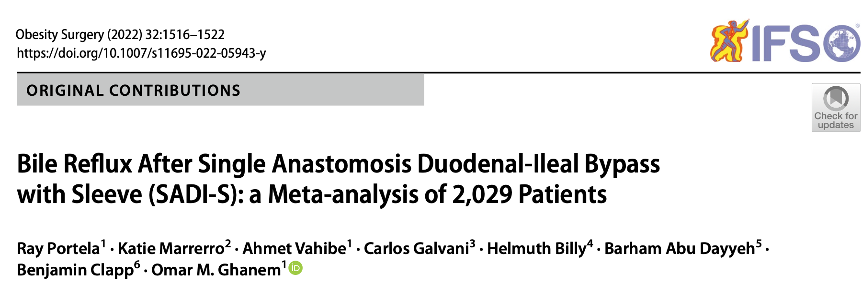
PAIR 2 | BILE REFLUX
Bile reflux after SADI-S: low incidence, but what does 1.23% really mean?
Portela et al. 2022 • 7 observational studies • 2,029 patients
POOLED INCIDENCE
25 / 2,029 patients
1.23% reported bile reflux
Random-effects event rate: 0.016
95% CI: 0.004–0.055
-->
Pylorus preservation + post-pyloric reconstruction may reduce bile reflux.
But the loop configuration still permits bile to reach the sleeve.
→ Authors suggest that pyloric insufficiency/hypotonia may contribute.
WHY 1.23% IS NOT THE WHOLE STORY
PILORUS + LOOP
-->
Mean follow-up ≈ 10.3 months (range 6–28 months)
6/7 studies were retrospective; only 2 clearly described diagnostic criteria.
GRADE: VERY LOW certainty
→ Short follow-up + diagnostic heterogeneity may have underestimated late bile reflux.

Slide 19
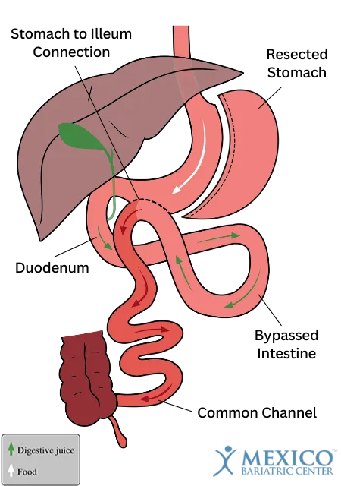
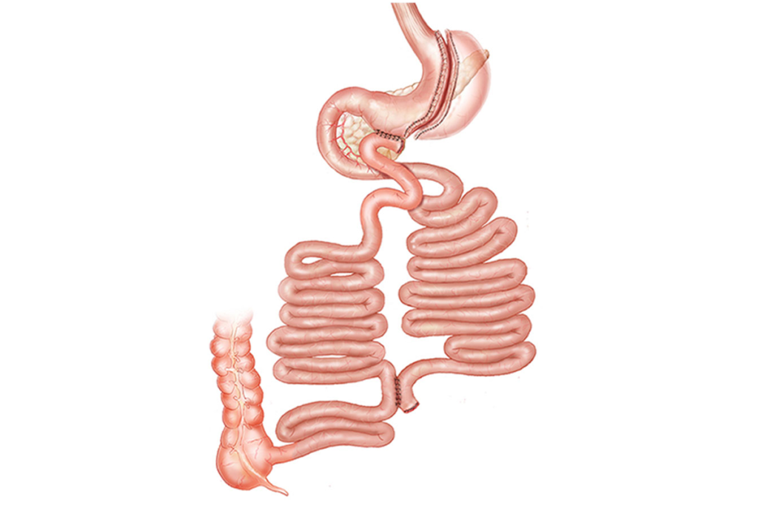
PAIR 3 | ANATOMY
Transit bipartition vs SASI
Both exploit intestinal bipartition to combine restriction with a distal intestinal signal.
TRANSIT BIPARTITION
SASI
Sleeve
+ intestinal bipartition
Food reaches distal ileum through a shortcut while retaining a physiologic route
Sleeve
+ loop gastro-ileal anastomosis
Simpler reconstruction, but wider variation in configurations

Slide 20
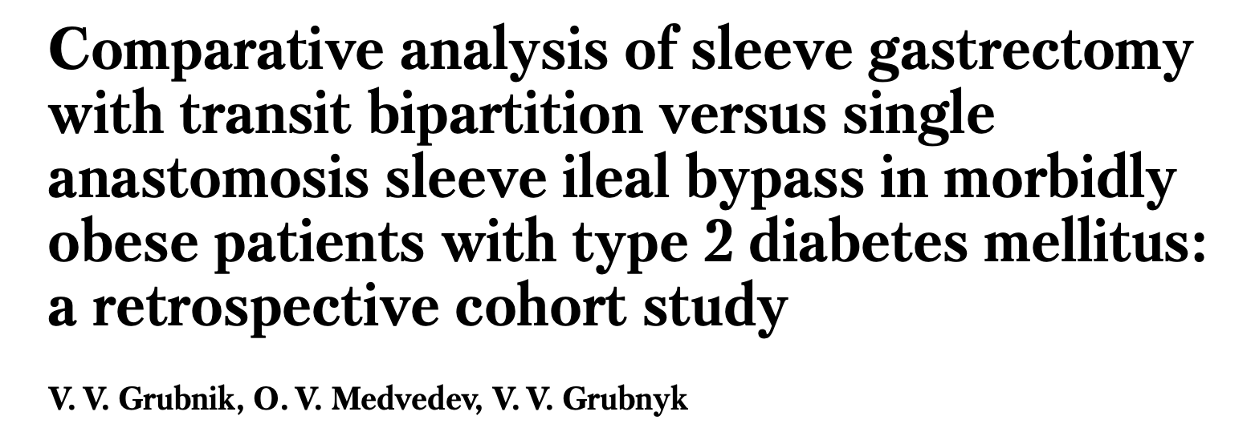
PAIR 3 | SHORT TERM
Technical simplification favors SASI
Grubnik et al. 2025 • retrospective cohort • n=33 • SG+TB 12 / SASI 21 • follow-up 6–48 months
EARLY SAFETY
No serious intraoperative complications or mortality.
Postoperative bleeding: 1 case in each group.
Pulmonary embolism: 1 case after SASI.
Internal hernia: 1 case after TB, requiring laparoscopic reoperation.
158 min
112 min
−46 min
SG + Transit Bipartition
mean operative time
SASI
mean operative time
SASI vs TB
p < 0.05

Slide 21
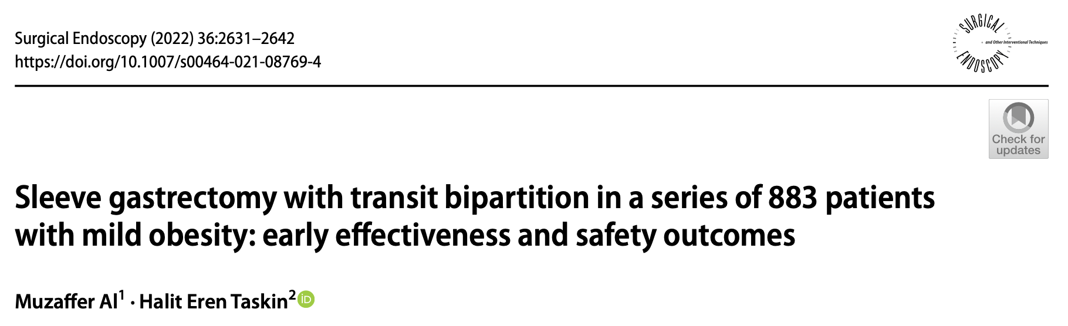
PAIR 3 | SHORT TERM
Transit Bipartition: effective at 12 months
Al & Taskin 2022 • single-center retrospective analysis of prospectively collected data • n=883 • 73.2% follow-up at 12 months
83.3%
HbA1c normalization
12 months
12-mo BMI (kg/m²)
34.1 at baseline
WEIGHT LOSS
19.8%
HTN: 43.5% → 6.3%
Hyperlipidemia: 21.5% → 2.5%
Hypertriglyceridemia: 47.3% → 9.6%
All p < 0.001
Safety: 10.2% overall complications; 0% mortality.
12-mo %TWL
646 patients
27.2%

Slide 22
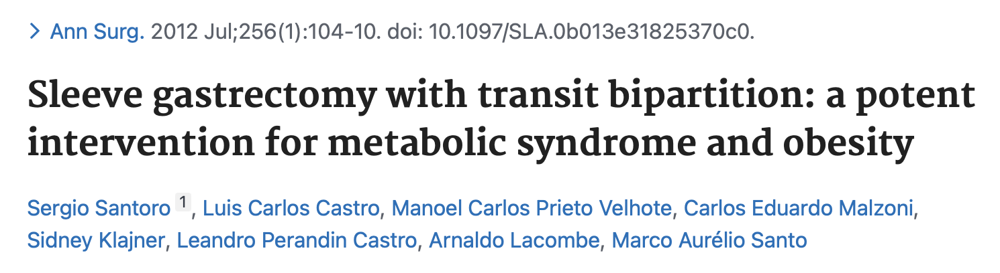
PAIR 3 | 5 YEARS
Transit Bipartition: the 5-year benchmark
Santoro et al. 2012 • n=1,020 • prospective database series • 59.1% follow-up through 5 years
WEIGHT LOSS
5-y %EBMIL
74%
peak %EBMIL at 2 years
94%
T2DM 86% • HTN 72% • dyslipidemia 85% • OSA 91%

Slide 23
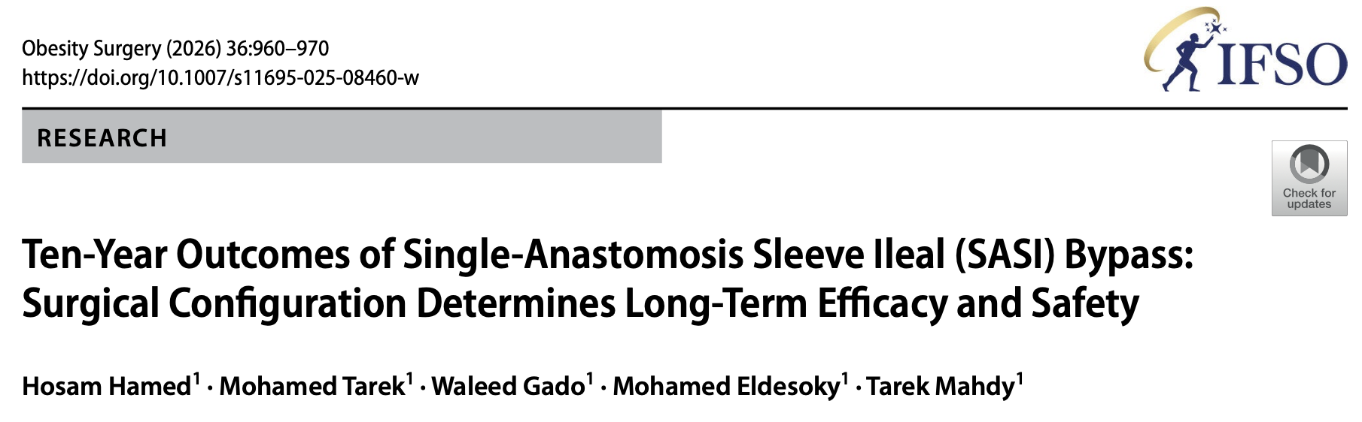
PAIR 3 | LONG TERM
SASI at 10 years
Hamed et al. 2026 • retrospective single-center cohort • 95 final patients • 89 with 10-year data (93.7%)
10-YEAR WEIGHT LOSS
METABOLIC DURABILITY
NUTRITIONAL RISK
REFLUX
Overall mean %EWL: 58.6 ± 20.3%
83.1% maintained ≥50% EWL
Mean %EWL by configuration:
1)30.2% — 250 cm / 4–6 cm
2)57.0% — 300 cm / 2.5 cm
3)62.5% — 350 cm / 2.5 cm
P < 0.001
T2DM remission: 88.2% overall
Group 3 (350 cm / 2.5 cm): 100%
Hypertension remission: 70% overall
Dyslipidemia remission: 78% overall
→ Metabolic efficacy remained high at 10 years.
Group 1 — 250 cm / 4–6 cm:
• Protein malnutrition 27%
• Iron-deficiency anemia 53%
• Chronic diarrhea/steatorrhea 33%
• Reversal for malnutrition 40%
→ The short, wide configuration was clearly unsafe long term.
Pre-op GERD: 12.6%
• Resolution 83%
• 4 new mild GERD cases — all Group 1
• Bile reflux 3.1% — all Group 1
Groups 2–3: no de novo GERD or bile reflux reported.
At 10 years, SASI remained metabolically effective, but the long-term safety signal was strongly configuration-dependent. A 350-cm common channel with a 2.5-cm anastomosis provided the best efficacy–safety balance.

Slide 24
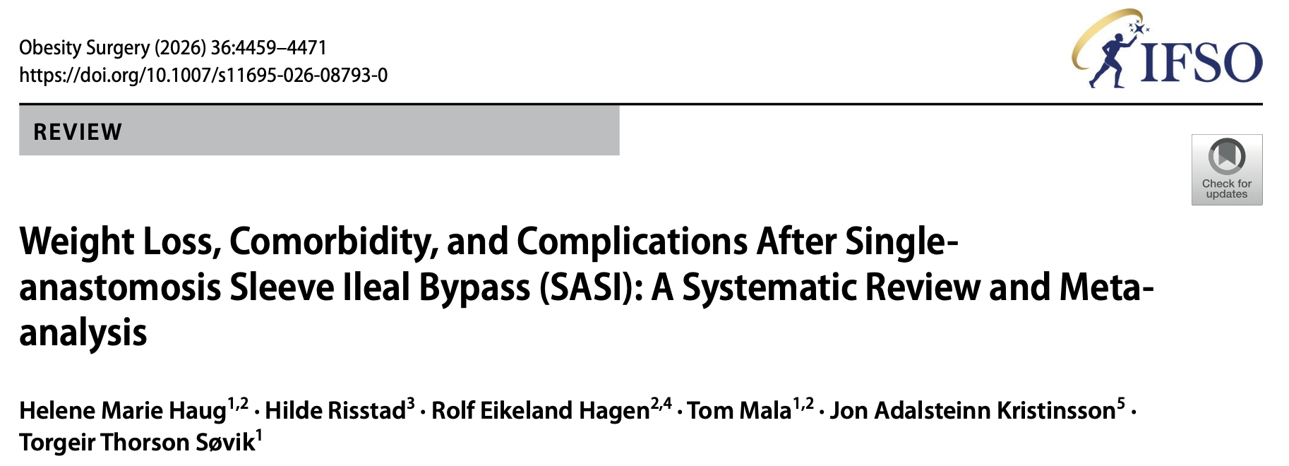
PAIR 3 | EVIDENCE SYNTHESIS
SASI, promising outcomes, but evidence certainty remains low
Haug et al. 2026 • systematic review/meta-analysis • 26 studies • 1,603 patients
EVIDENCE BASE
WEIGHT + METABOLIC
SAFETY
Pooled single-arm %TWL:
35.9% (95% CI 33.3–38.5)
T2DM remission:
91% pooled probability (95% CI 85–96)
Dyslipidemia remission:
91% (95% CI 84–96)
Reoperations: 99/1,698 (5.8%)
Median follow-up: 12 months
→ Long-term safety remains inadequately characterized.
26 studies
• 3 RCTs
• 7 NRCTs
• 16 single-arm cohorts
Median follow-up: 12 months
Most studies reported only 1-year outcomes.
SASI shows substantial metabolic efficacy, but the current comparative evidence is too small, heterogeneous. Long-term RCT data are still needed.

Slide 25
THE 10-YEAR TEST
What should every bariatric surgeon care about at year 10?
Weight loss alone is an incomplete endpoint.
WEIGHT
METABOLIC
GI PHYSIOLOGY
Durability
Weight regain
Body composition
Diabetes
Hypertension
Lipids
GERD
Bile reflux
Ulcer
Dumping
NUTRITION
REVISION
SURVEILLANCE
Protein
Iron / B12
Fat-soluble vitamins
Why was the patient revised?
Was it preventable?
Can we still investigate the stomach and oesophagus?
Long-term success = efficacy − complications − nutritional burden − revisional burden.

Slide 26
EVIDENCE HIERARCHY
Not all “data” are equal
Duration matters but design, follow-up completeness and standardization matter too.
LEVEL 1
LEVEL 2
LEVEL 3
LEVEL 4
Randomized comparative evidence
Best for causal inference
Prospective / multicenter cohorts
Strong external validity
Retrospective matched cohorts
Useful, but selection bias remains
Single-arm series
Hypothesis-generating
Current landscape: RYGB has the deepest track record; OAGB and SADI-S now have meaningful 5/10-year comparative evidence; TB/SASI remain less mature.

Slide 27
DECISION ALGORITHM
How we translate the evidence into a patient-specific choice
Severe GERD / Barrett’s?
→ Favor RYGB
STEP 1
No dominant reflux + need for powerful, durable metabolic effect?
→ OAGB becomes highly attractive
STEP 2
Extreme obesity + maximal metabolic target + excellent follow-up?
→ Consider OAGB / SADI / DS
STEP 3
Selected metabolic phenotype + high adherence + experienced center?
→ TB / SASI may be considered
STEP 4
Can this patient safely live with this anatomy for the next 10–20 years?
STEP 5

Slide 28
THE ANSWER
So… is two better than one?
01
Two anastomoses
can buy physiological control, especially reflux control, at the cost of complexity.
One anastomosis
can buy simplicity without sacrificing efficacy, if we actively manage its specific long-term risks.
02
The number of anastomoses is not the endpoint.

Slide 29
TAKE-HOME MESSAGES
Fewer anastomoses reduce technical complexity, not necessarily long-term risk.
In general, one anastomosis procedures seem to favor bile reflux while conversely two anastomoses favor internal hernias.
Durable efficacy is possible, but nutritional and reflux trade-offs remain crucial.
Surgical configuration can be as important as the procedure itself.
Long-term evidence still favors established procedures.
The best operation is the one with the best benefit–risk balance for the patient.

Slide 30
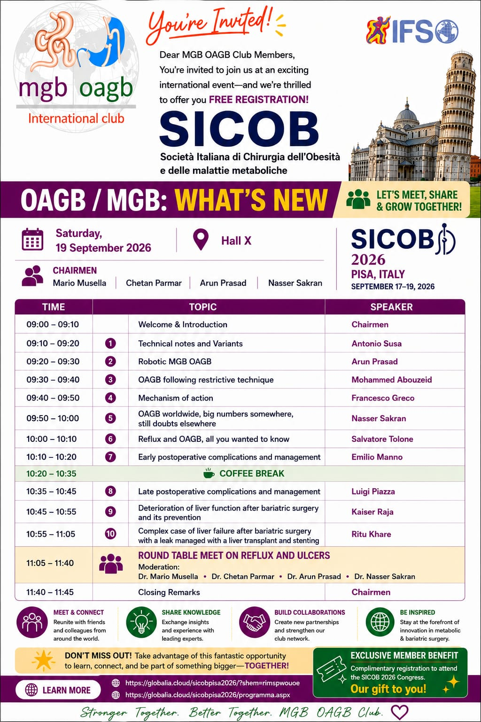
Thank you!
mario.musella@unina.it

